Slide 1


Nishant Sandal
April 14, 2024

Slide 2

Outline
Executive Summary
Introduction
Methodology
Results
Conclusion
Appendix

Slide 3
Executive Summary
Summary of methodologies
API Calls
Web Scrapping
Data Wrangling
Exploratory Data Analysis with Data Visualization
Exploratory Data Analysis with SQL
Interactive Map Construction via Folium
Interactive Dashboard Construction via Plotly
Machine Learning Algorithm Training
Summary of all results
Data Visualization/SQL Outcomes
Map and Dashboard Outcomes
Machine Learning Outcomes

Slide 4
Introduction
Project background and context
Problems you want to find answers

Slide 5

Section 1

Slide 6
Methodology
Executive Summary
Data collection methodology:
API Calls and Web-scraping were used to pull data from SpaceX, IBM, and Wikipedia
Perform data wrangling
Exploring the data types allowed me to change the launch outcomes into a new 'Class’ category, utilizing one-hot encoding to allow for later data manipulation
Perform exploratory data analysis (EDA) using visualization and SQL
Perform interactive visual analytics using Folium and Plotly Dash
Perform predictive analysis using classification models
Using GridSearchCV, fit_transform(), and fit() on various Machine Learning models, parameters which maximized the R^2 value were determined.

Slide 7
Data Collection
API calls requests to get datasets of SpaceX and IBM. Responses were uploaded into data frames which includes data about rocket booster versions, cores, payloads, and launchpad details
An API call initiated to get launch data in a json file which was then normalized and converted into a more easily readable Pandas DataFrame.
All of the data gathered consolidated into a single data frame and fill missing values by taking average.
Additional launch data gathered by using web-scraping from Wikipedia using BeautifulSoup. Data were converted into a Pandas data frame

Slide 8
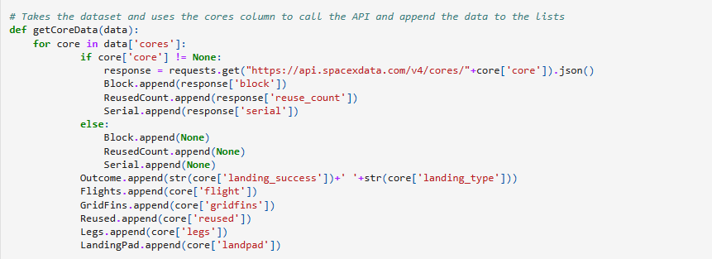
Data Collection – SpaceX API
requests.get() was used to obtain data
For each category of interest, a function was defined that would obtain its data then append it into a data frame
The response was appended into empty data frame
GITHUB URL : Project/Spacex-data-collection-api-jupyter-notebook.ipynb at main · ni-shnt/Project (github.com)

Slide 9
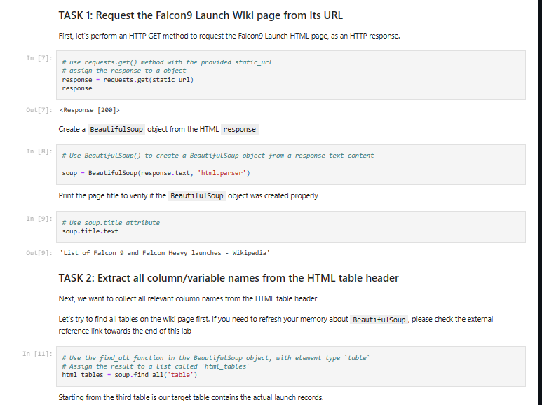
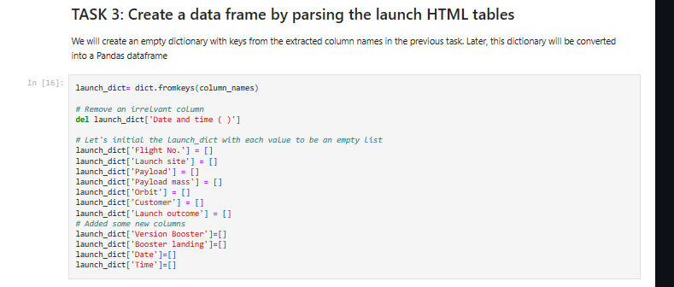
Data Collection - Scraping
requests.get() was used with BeautifulSoup to extract information from the SpaceX Falcon 9 Launch details from Wikipedia
The response was then parsed through by searching for all present 'th', signifying headers
The headers and their data were later extracted using a collection of given functions and stored in a dictionary
The dictionary was converted into a Pandas data frame
GitHub URL : https://github.com/ni-shnt/Project/blob/main/jupyter-labs-webscraping%20(1).ipynb

Slide 10
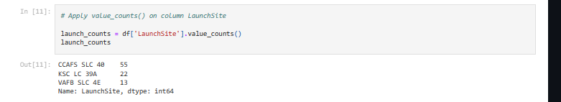
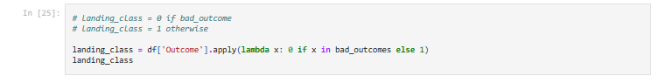
Data Wrangling
The landing outcomes were separated into two different groups (successful and failed)
Using one-hot encoding
The data frame was then appended with the new 'Class' column
GitHub URL: Project/labs-jupyter-spacex-Data wrangling (1).ipynb at main · ni-shnt/Project (github.com)

Slide 11
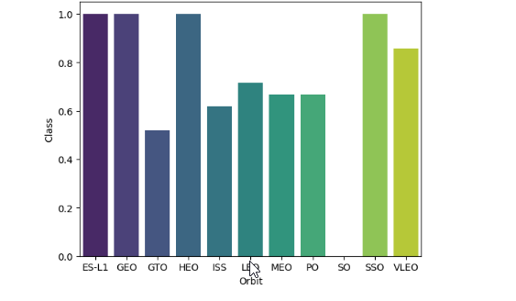
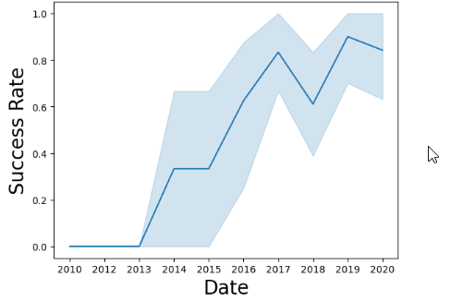
EDA with Data Visualization
A bar chart is used to visualize success rates of landings from different orbits.
A line graph was used to visualize success rates of landings by year.
Github URL : Project/EDA with Visualization.ipynb at main · ni-shnt/Project (github.com)

Slide 12
EDA with SQL
Using SQL with Jupyter notebook Some of the queries included:
Average payload mass carried by Falcon 9 v1.1
First successful groundpad landing date.
Successful missions versus failed missions.
Boosters that has ability to carry highest payload mass
Boosters that carries payload within 4000kg and 6000kg range.
GitHub URL: Project/jupyter-labs-eda-sql-coursera_sqllite.ipynb at main · ni-shnt/Project (github.com)

Slide 13
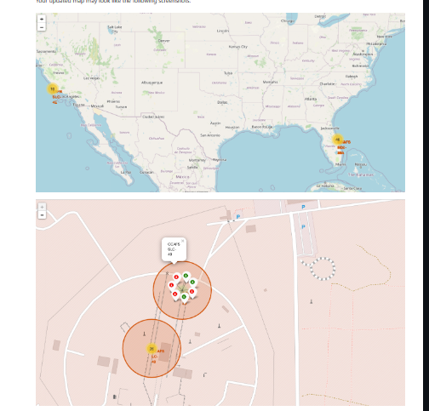
Build an Interactive Map with Folium
Folium map:
Circular markers were used to four specific SpaceX launch sites to launch F9 rocket.
Colored markers were used to denote launch success (green) or failure (red).
Visualizing the successes and failures of each launch site via a Folium and it is helpful in visualizing the success rates.
GitHub URL: Project/lab_jupyter_launch_site_location.ipynb at main · ni-shnt/Project (github.com)

Slide 14
Build a Dashboard with Plotly Dash
A dropdown menu that allows selection of a specific launch site.
A slider was included in order to adjust the payload weight.
A pie chart was included to display different launch site success rates.
A scatter plot was added to help visualize successes of different booster.
GitHub URL: Project/spacex_dash_app.py at main · ni-shnt/Project (github.com)

Slide 15
Predictive Analysis (Classification)
Data was loaded into a Numpy array regarding launch success.
Split training and testing datasets
GridSearchCV used to determine the best parameters and best possible R^2 accuracy score for the landing data amongst others.
The most accurate model was selected from the options.
A confusion matrix was plotted for each method
A bar chart was made to display the maximum potential accuracy of each method
GitHub URL: Project/SpaceX_Machine Learning Prediction_Part_5.ipynb at main · ni-shnt/Project (github.com)

Slide 16
Results
Exploratory data analysis results
Interactive analytics demo in screenshots
Predictive analysis results

Slide 17

Section 2

Slide 18
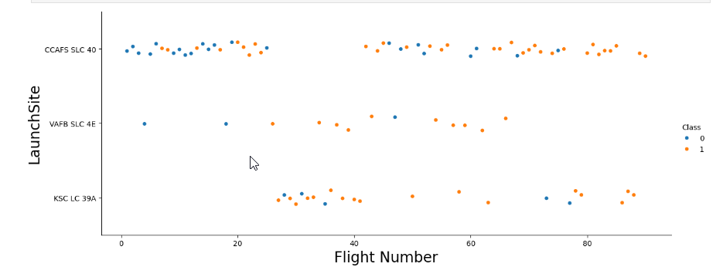
Flight Number vs. Launch Site
Given that the flight numbers are ordered by date (lower number = earlier date), the success rate has improved over time
Most of the unsuccessful landings occur at CCAFS SLC 40
Most of the successful landings occur at KSC LC 39A

Slide 19
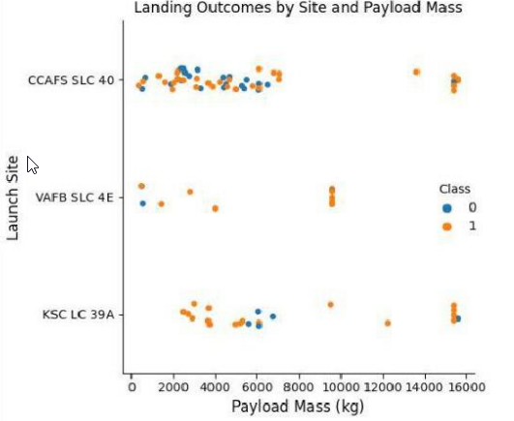
Payload vs. Launch Site
KSC LC 39A is the most successful in the lower payload mass range (0- 5000kg)
Payload masses between 8000kg and 14000kg have all been successful

Slide 20
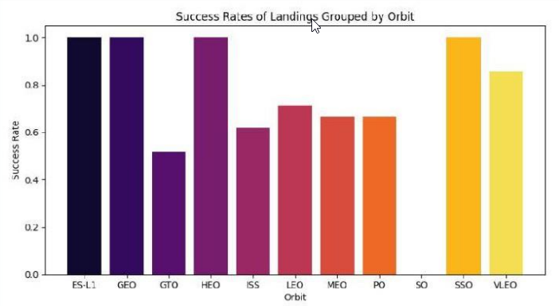
Success Rate vs. Orbit Type
ES-L1, GEO, HEO, and SSO are the most successful orbits
VLEO has 80% success rate.
Launches from GTO, the ISS, or SO have proven very risky for landing (60% success rate or lower)

Slide 21
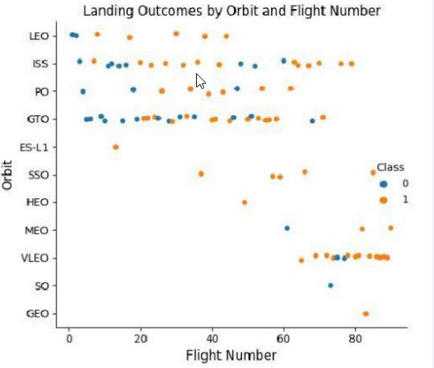
Flight Number vs. Orbit Type
Launches to orbits including the ISS and GTO can have more risk included.
LEO, SSO and VLEO are highly risk free.

Slide 22
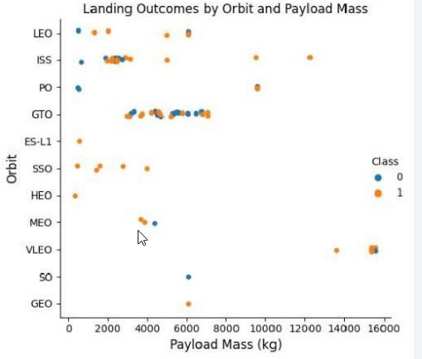
Payload vs. Orbit Type
SSO has 100 success record for payloads approx. 2000KG
GTO has risk included in all payload ranges

Slide 23
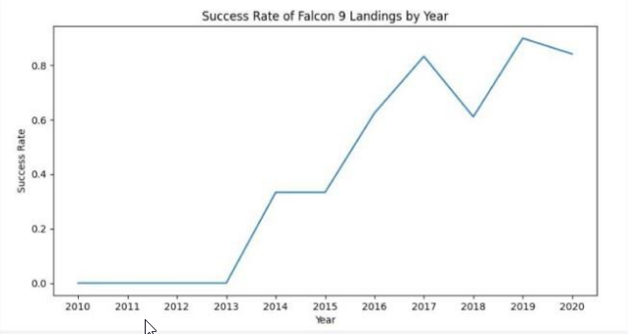
Launch Success Yearly Trend
Success Rates of Falcon 9 landing has improved drastically since 2010 to 2020

Slide 24
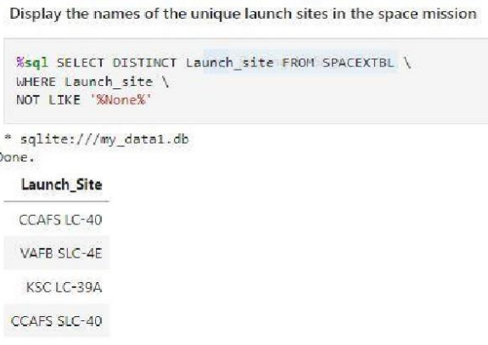
All Launch Site Names
The query returned all unique launch site names
The NOT LIKE '%None%' was added in order to eliminate a 'None' that would appear when querying for the launch sites

Slide 25
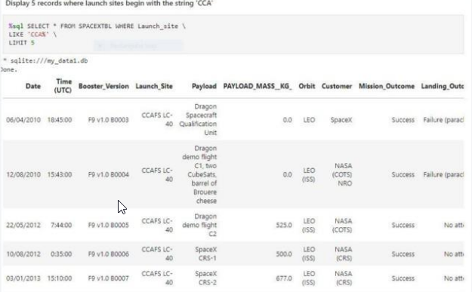
Launch Site Names Begin with 'CCA'
The query returns the first 5 records started with CCA in Launch Site name.

Slide 26
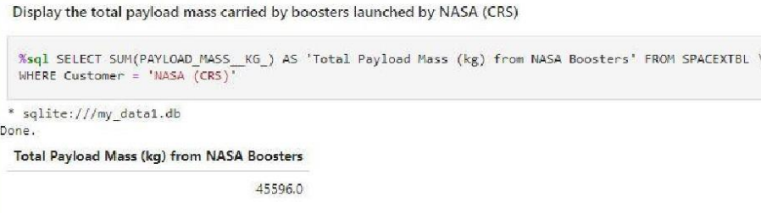
Total Payload Mass
The query sum PAYLOAD_MASS_KG_ column for customer NASA(CRS).

Slide 27
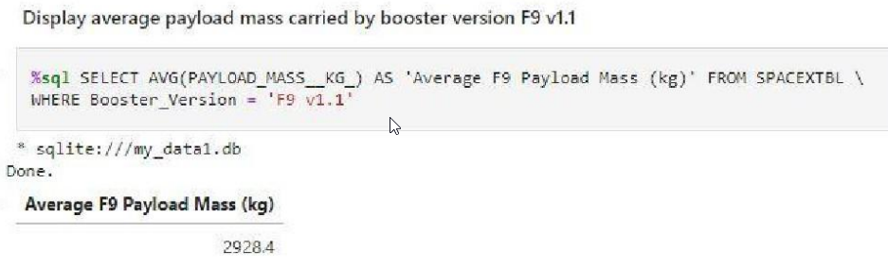
Average Payload Mass by F9 v1.1
The query returns the average payload mass carried by the F9 v1.1 booster
Obtained by using where condition that the booster version is F9 v1.1

Slide 28
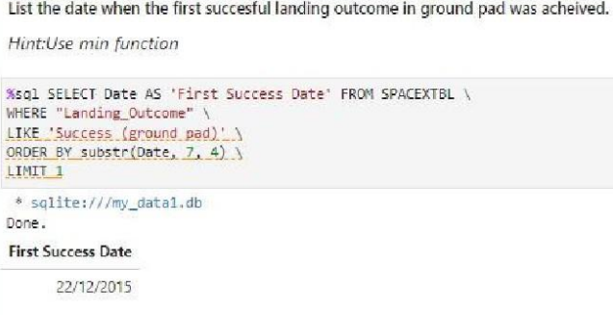
First Successful Ground Landing Date
The query was used to find the first date during which a ground landing was successful
Dates were not given in a 'year-first' format, the dates were all queried then ordered by year by using substr.

Slide 29
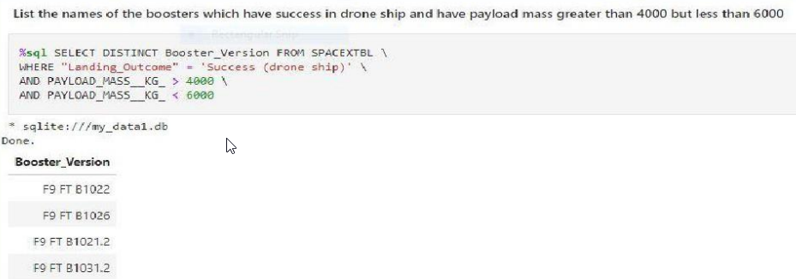
Successful Drone Ship Landing with Payload between 4000 and 6000
The query filtered the booster versions that were able to land safely on drone ship while carrying a payload mass between 4000kg and 6000kg.

Slide 30
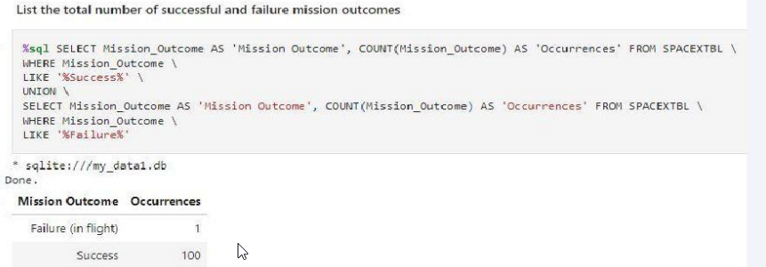
Total Number of Successful and Failure Mission Outcomes
The first query totals of all successful mission outcomes
The second query outputs all failed mission outcomes
The 'UNION' line combines both queries into one data frame
SpaceX has over a 99% mission success rate if the rocket gets off the ground

Slide 31
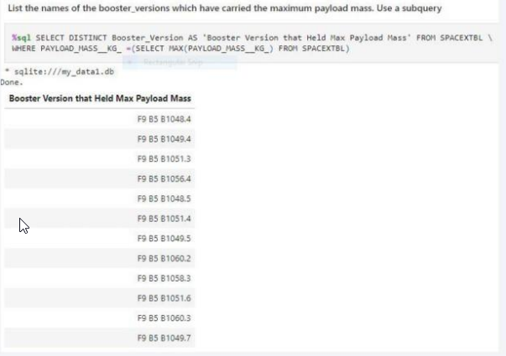
Boosters Carried Maximum Payload
The query shows all booster versions that have carried the maximum payload.

Slide 32
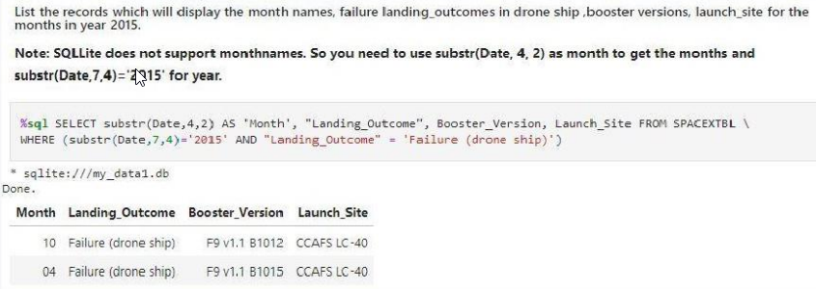
2015 Launch Records
• The query returns records for failed drone ship landings that occurred during 2015. The months are listed instead of the date.

Slide 33
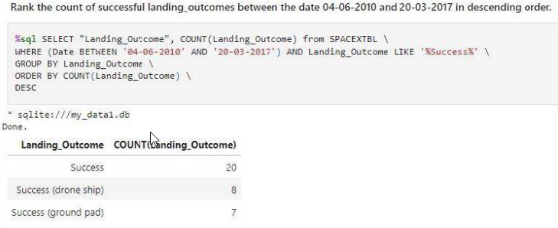
Rank Landing Outcomes Between 2010-06-04 and 2017-03-20
• The query shows the count of all successful Landing Outcomes between the dates of 06/04/2010 and 03/20/2017 in a desending order

Slide 34

Section 3

Slide 35
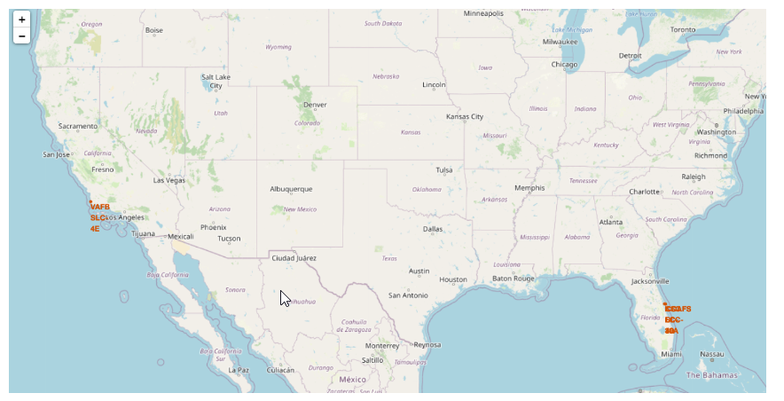
Launch Sites
SpaceX's launch sites

Slide 36
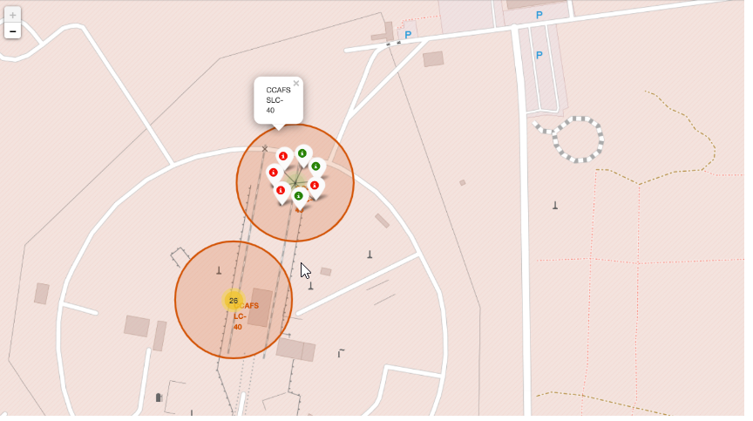
Successes on Launch Site
The California-based VAFB SLC-4E is pictured with markers denoting the SpaceX successes and failures that took place.

Slide 37
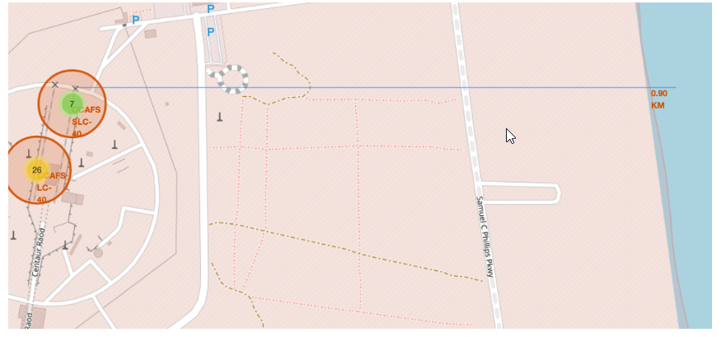
Launch Site Distance from City
Shows the distance between launching site and the coastline.

Slide 38

Section 4

Slide 39
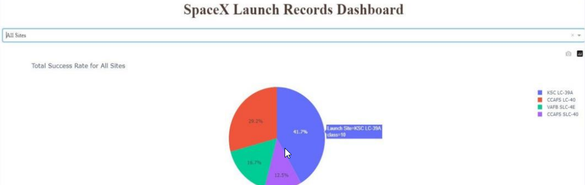
Launch Site Success
This dashboard shows the success rates of all the Launch Sites in Pie Chart.

Slide 40
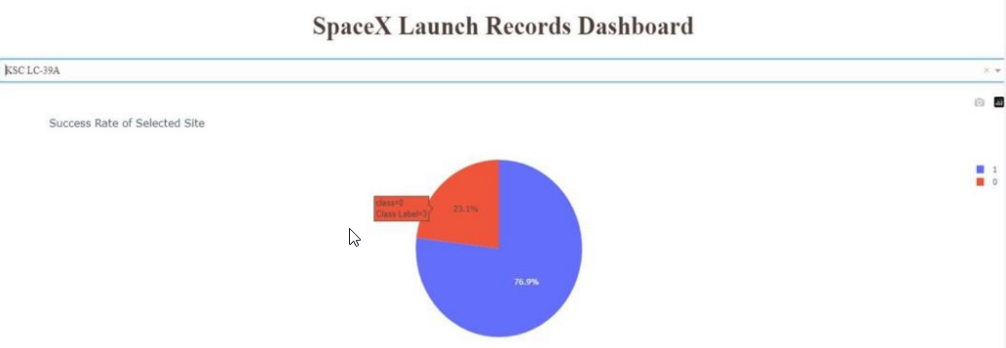
KSC LC-39A
KSC LC – Success and Failure Rate

Slide 41
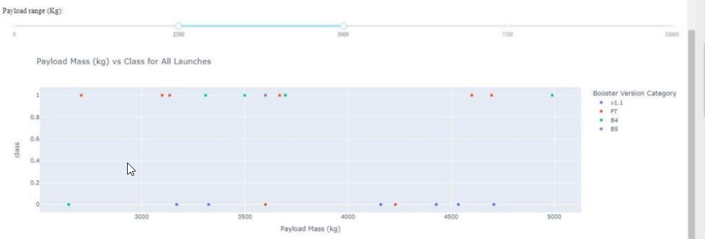
Scatter Plot of Success Rate for Varying Payloads
Slider for filtering payload masses.

Slide 42

Section 5

Slide 43
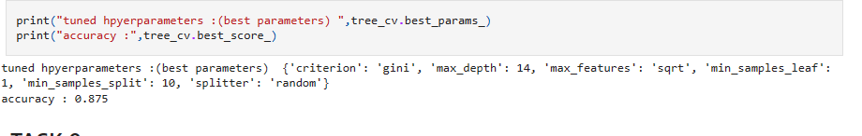
Classification Accuracy
Decision Tree has best accuracy as it has Accuracy of 87%

Slide 44
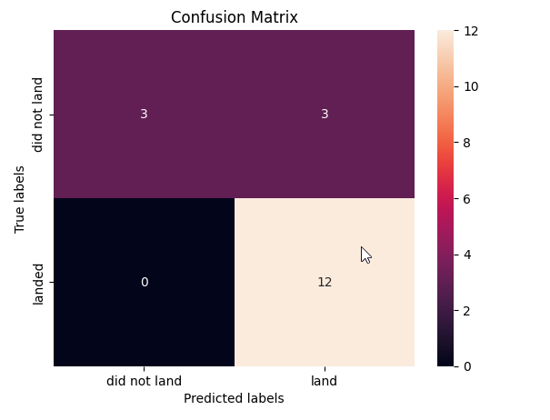
Confusion Matrix
Decision Tree does not create any Type 2 error (false negative).
All error was Type 1 error (false positive),

Slide 45
Conclusions
The highest payload mass have high success rates.
The orbits with highest success rates are closer to Earth, such as LEO, VLEO, and SSO. Farther orbits, such as GTO and ISS, are highly prone to failure.
The KSC LC-39A site has high success rates.
SpaceX has improved its accuracy since 2010 to 2020.
The decision tree model is the most accurate machine learning algorithm for predictive analysis of this data set.

Slide 46
Appendix
GitHub Repository URL:
https://github.com/ni-shnt/Applied-Data-Science-Capstone

Slide 47


